Slide 1
A Validated Low-to-Intermediate Mass Planetary Interior Structure Model and New Mass-Radius Relations
GLEAM Talk by Bennett Neil Skinner
2025/11/6

Slide 2
I. Motivation

Slide 3
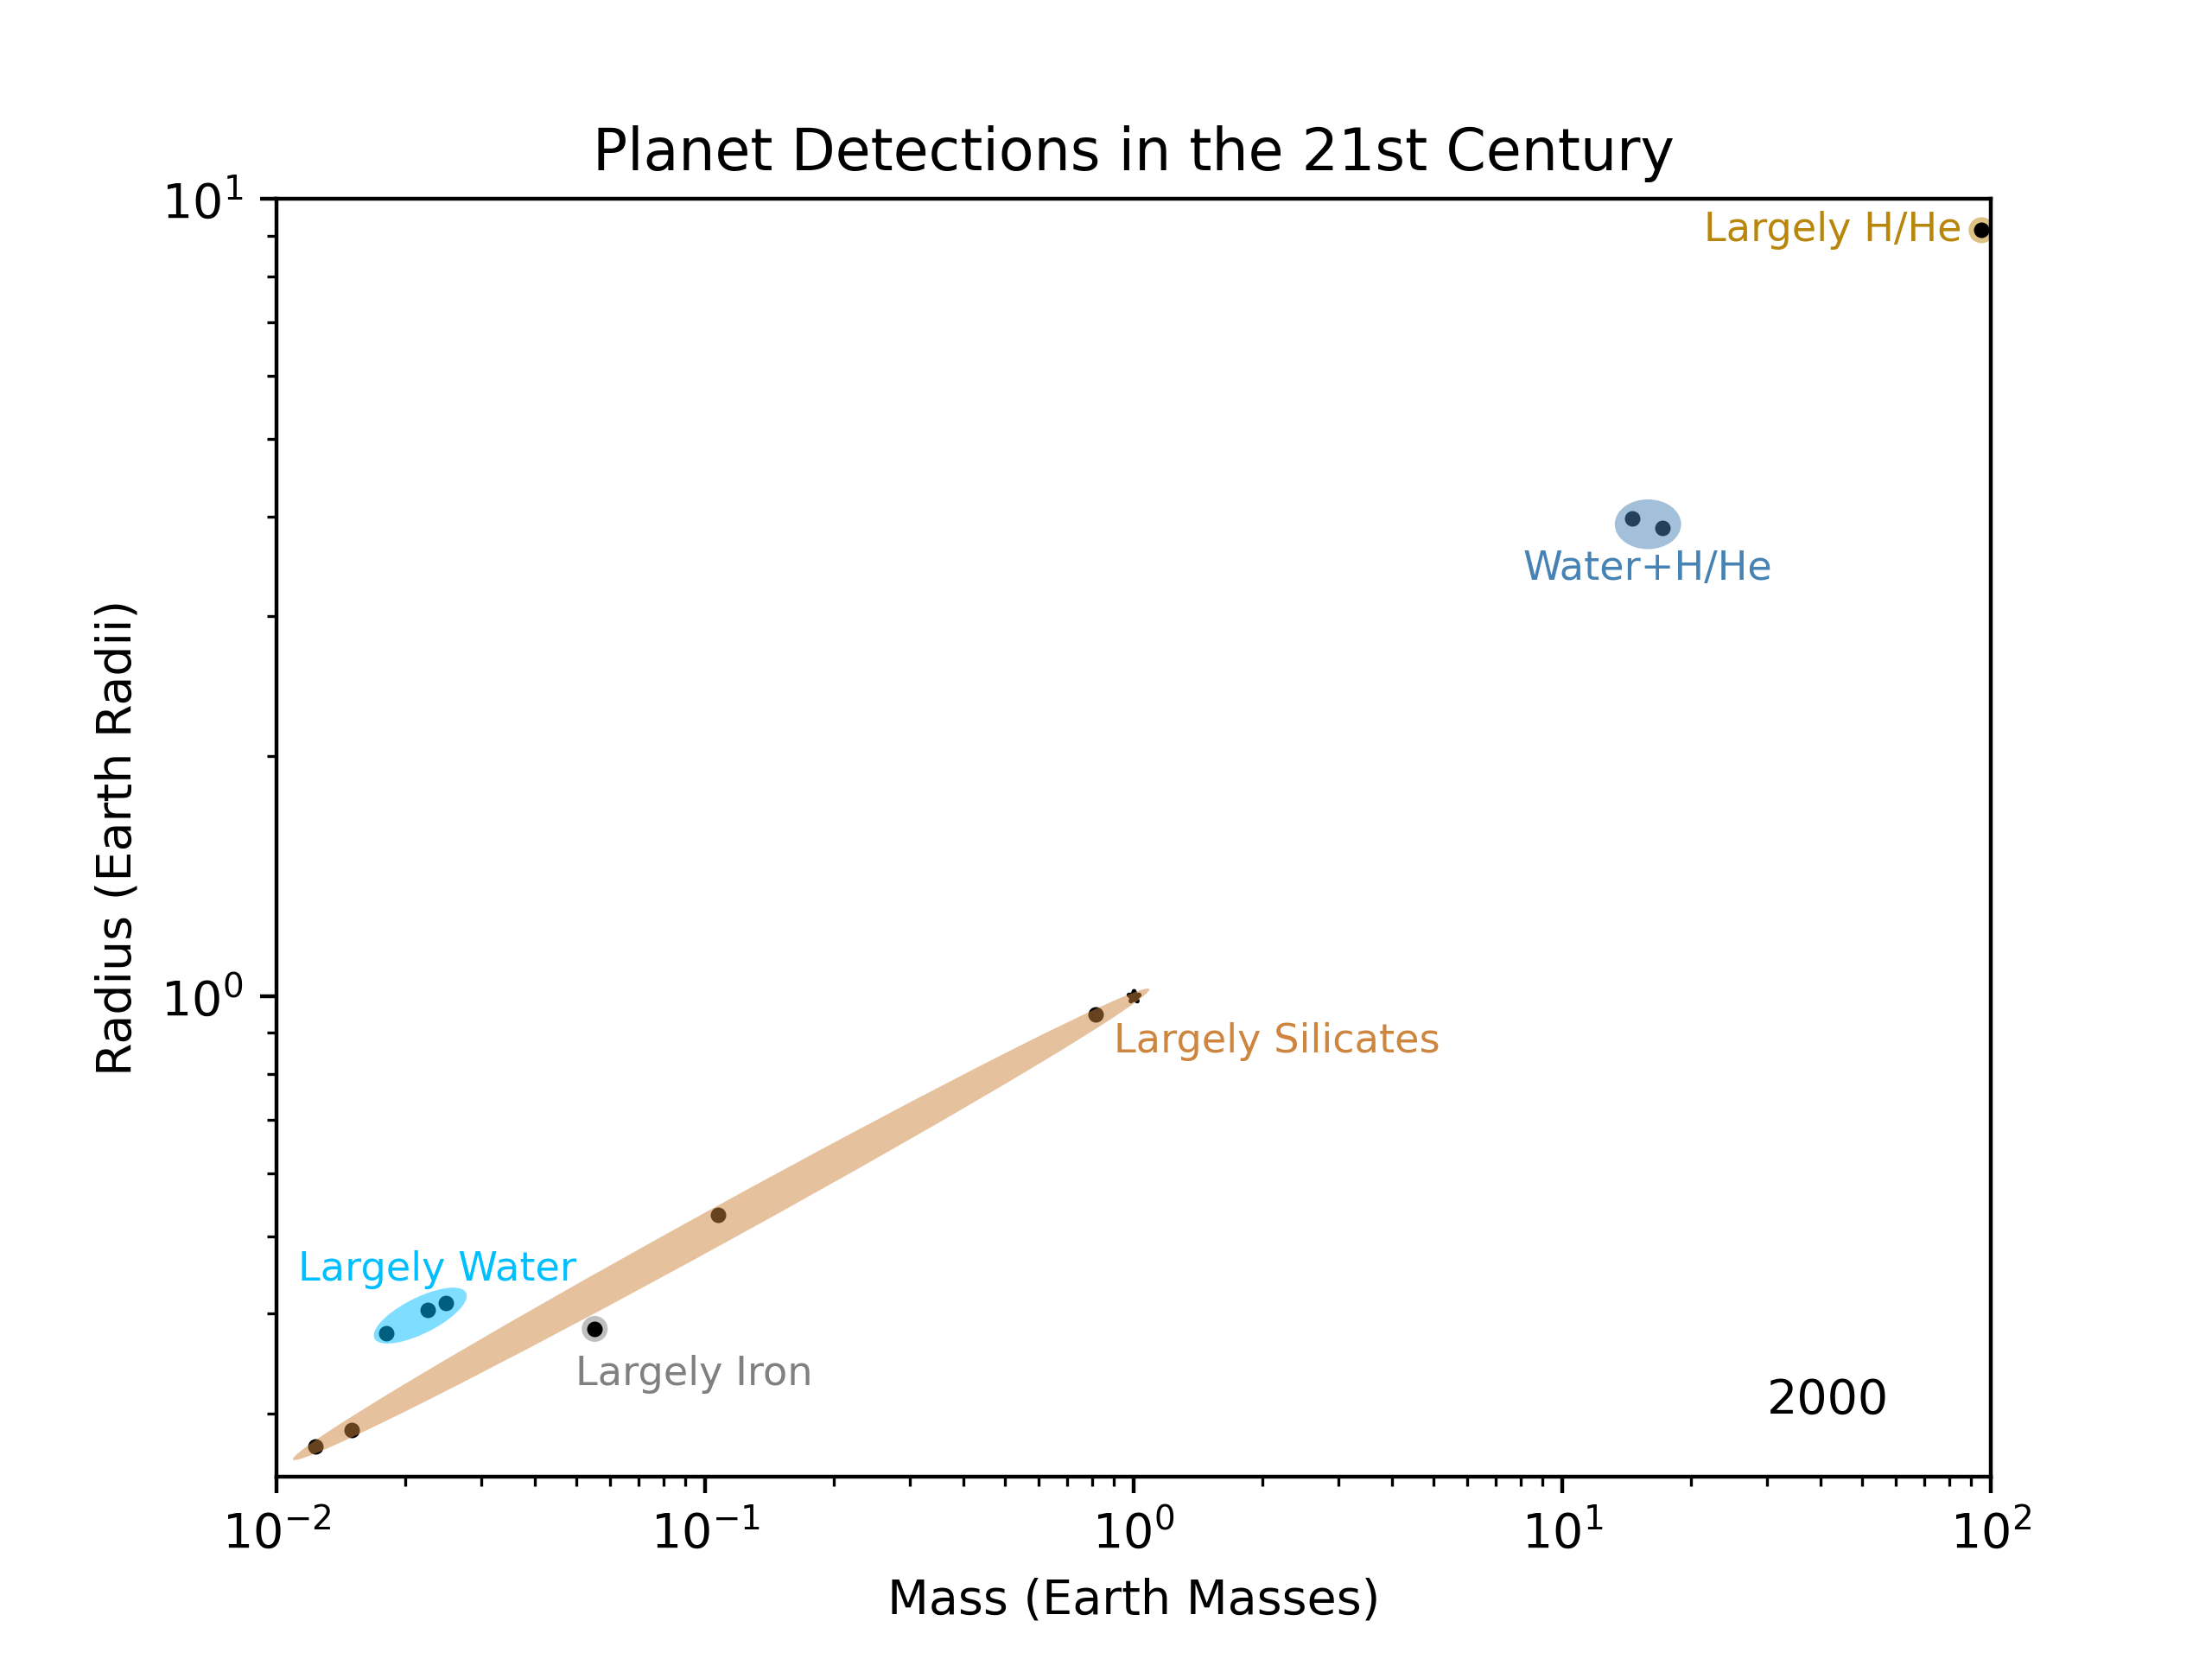

Slide 4
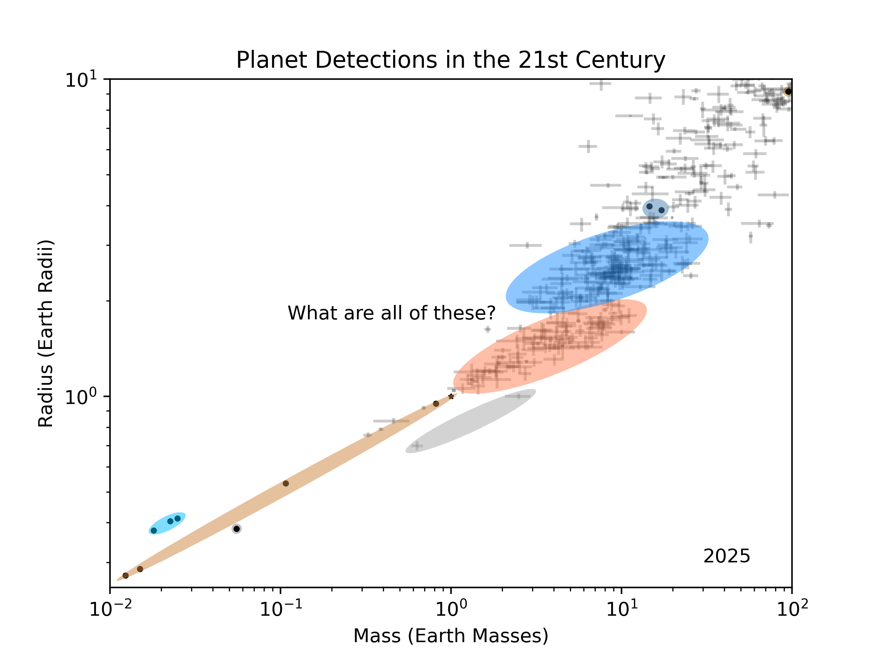

Slide 5
M-R Curves: Composition from Observation
Mass
Equilibrium Temperature
Composition
Interior Structure Model
Measured
Inferred
Radius

Slide 6
M-R Curves: Radius from Formation Model
Mass
Equilibrium Temperature
Composition
Interior Structure Model
Measured
Inferred
Radius

Slide 7
II. A New Model

Slide 8
Updated Equations of State
All Layers
EOS updated following latest experiments
Can be solid or molten
Several solid phases (iron: 3, mantle: 12+, water: 8)
Thermal terms in EOS included → Less dense planets
Iron
New better-extrapolating EOS (Hakim et al. 2018) → Denser planets
Inclusion of light elements in core (Like Earth) → Less dense planets
Partitioning of light elements between solid and liquid core
Mantle
Gibbs free energy minimization (Stixrude & Lithgow-Bertelloni 2024)
Inclusion of iron in mantle (Like Earth) → Denser planets
Water
AQUA model implemented (Haldemann et al. 2020) → Denser planets
Hydrogen/Helium
Non-ideal mixing of H/He (Chabrier & Debras 2021) → Denser planets

Slide 9
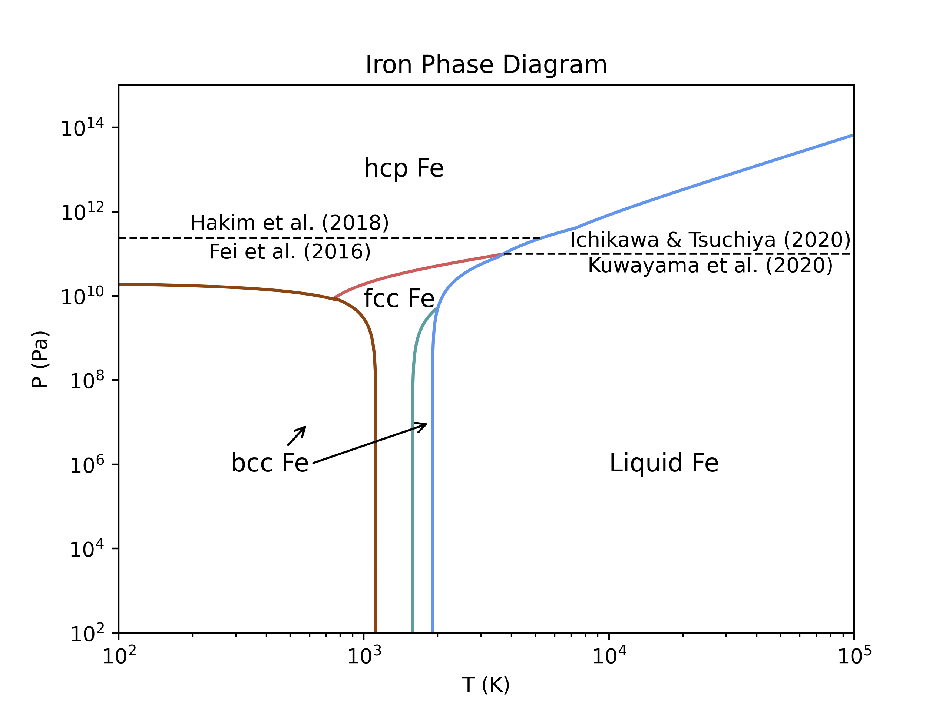

Slide 10
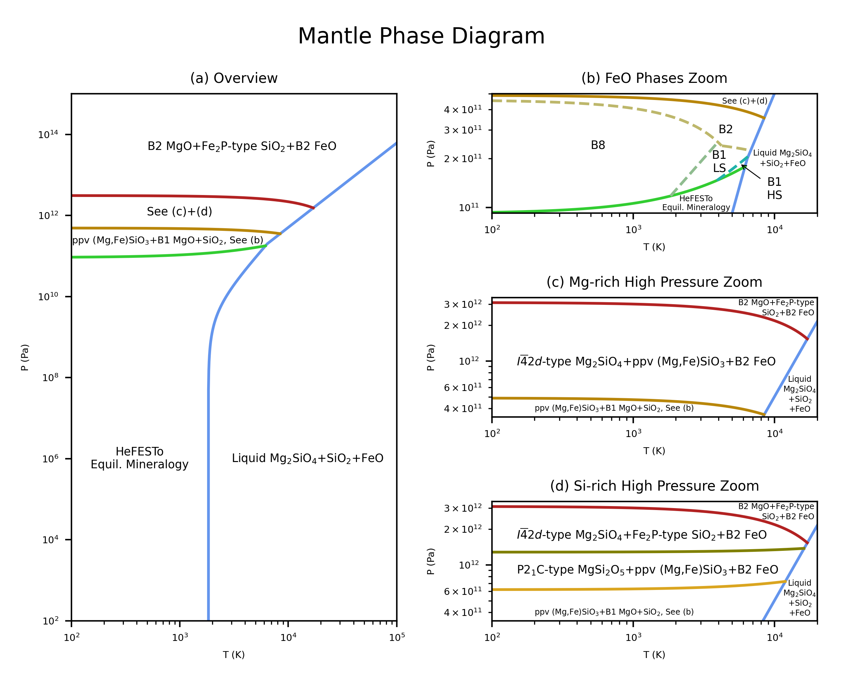

Slide 11
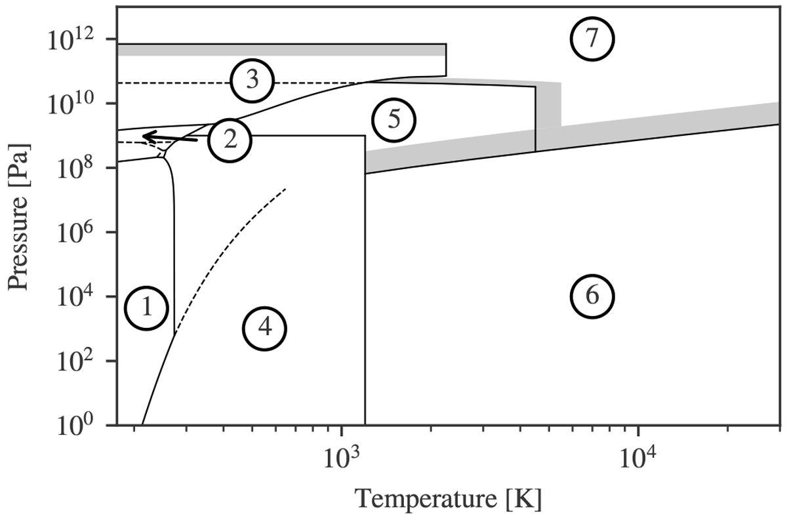
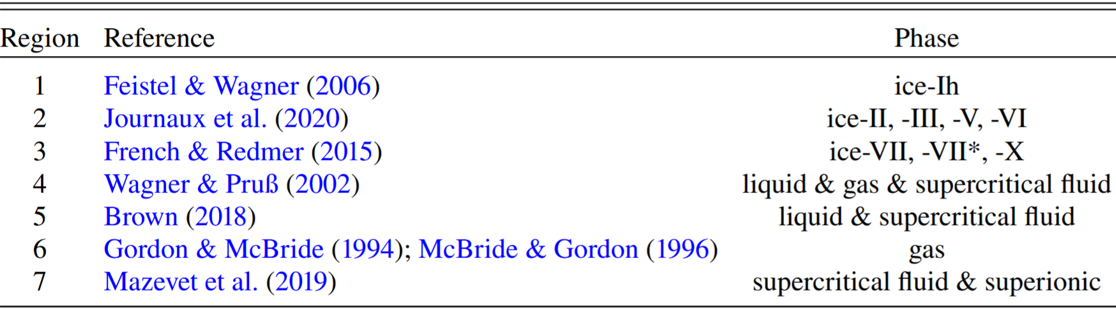
Water Phase Diagram
Haldemann et al. (2020)

Slide 12
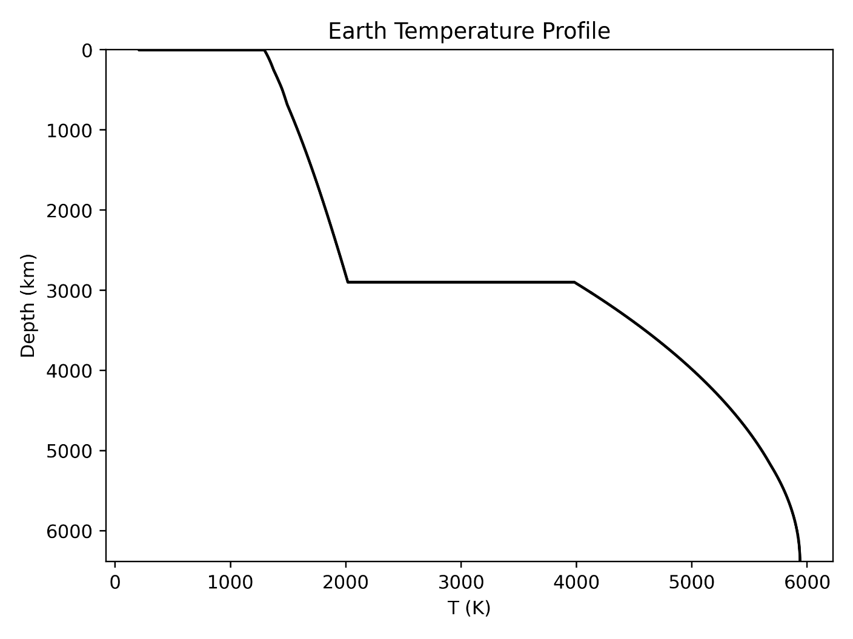
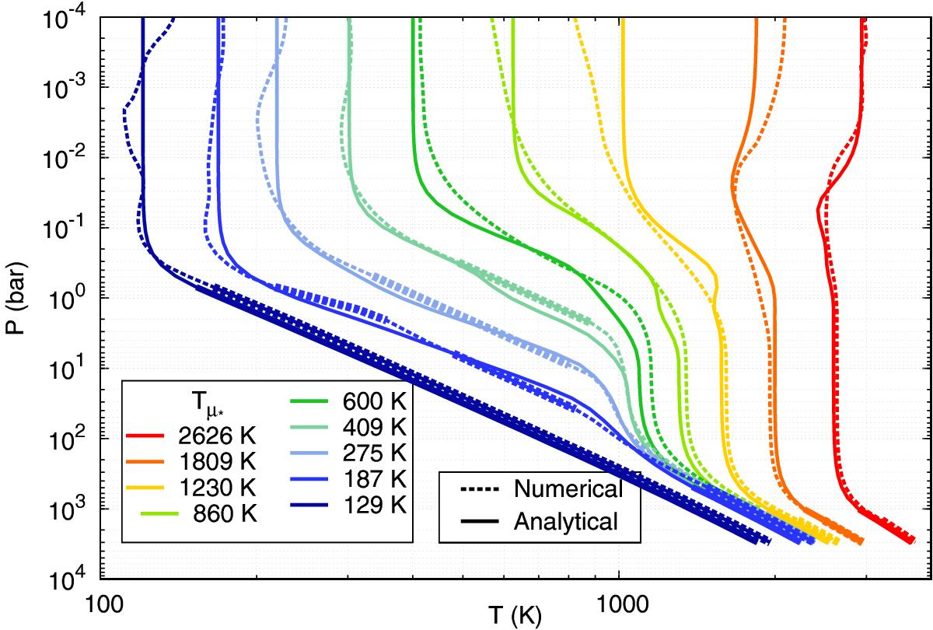
More Realistic Temperature Profile
T Jump at mantle top/bottom
Radiative Transfer in Atmosphere
Parmentier et al. (2015)

Slide 13
Planetary Transit Radii
Planetary Radius
Transit Radius

Slide 14
III. Validation

Slide 15
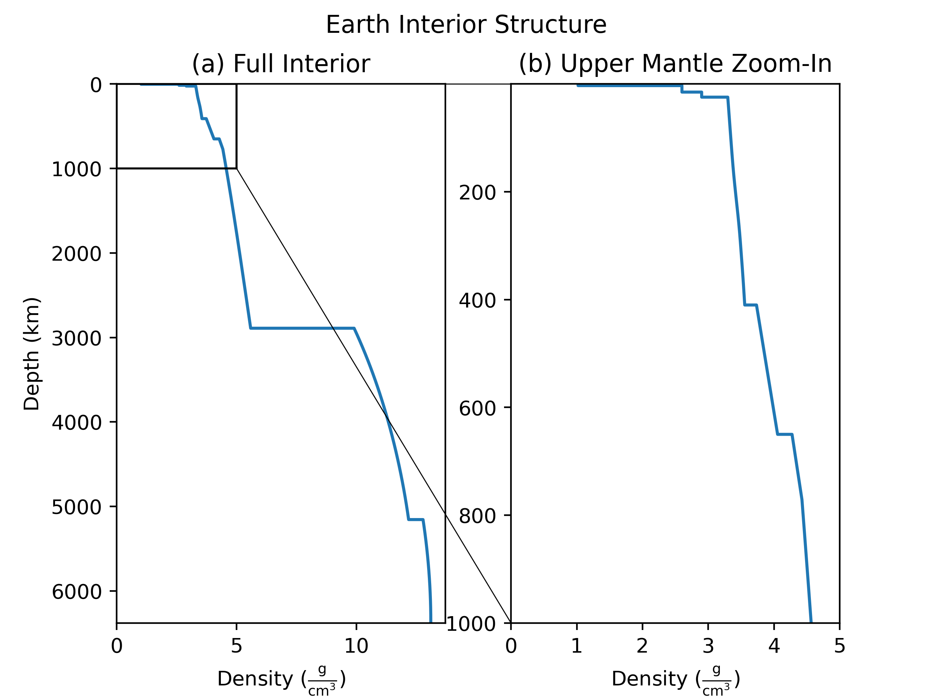

Slide 16
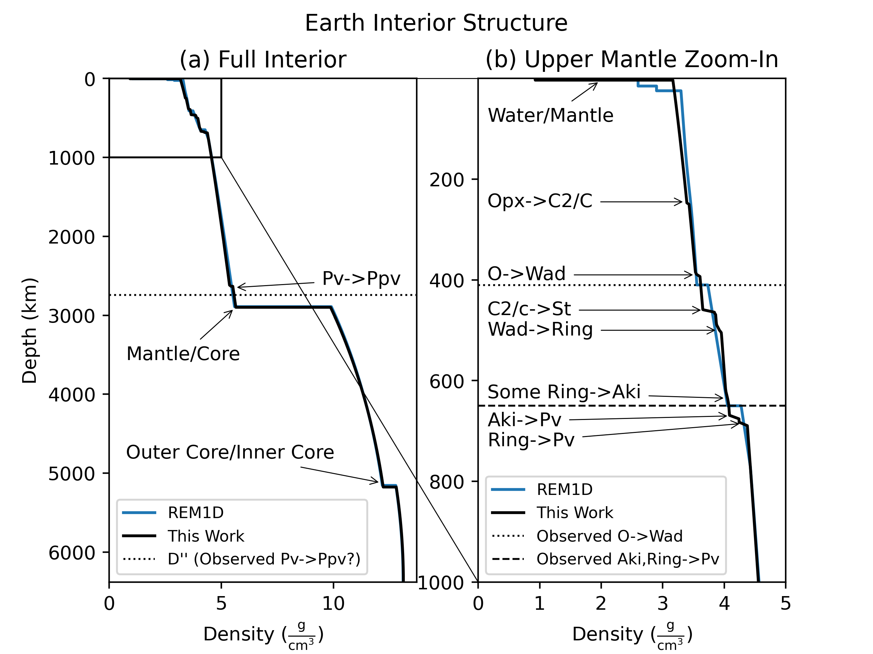
0.15% Radius Error
-0.16% MoI Coeff Error

Slide 17
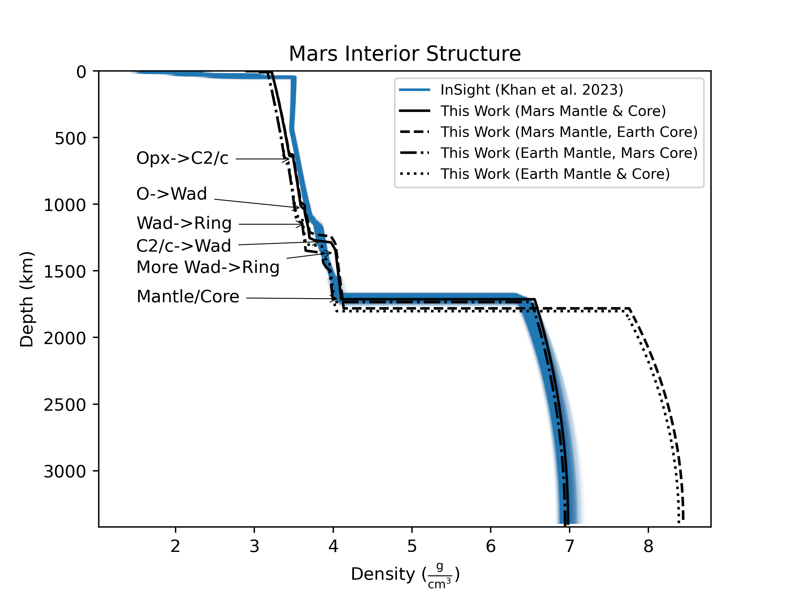
0.24% Radius Error
-0.40% MoI Coeff Error

Slide 18
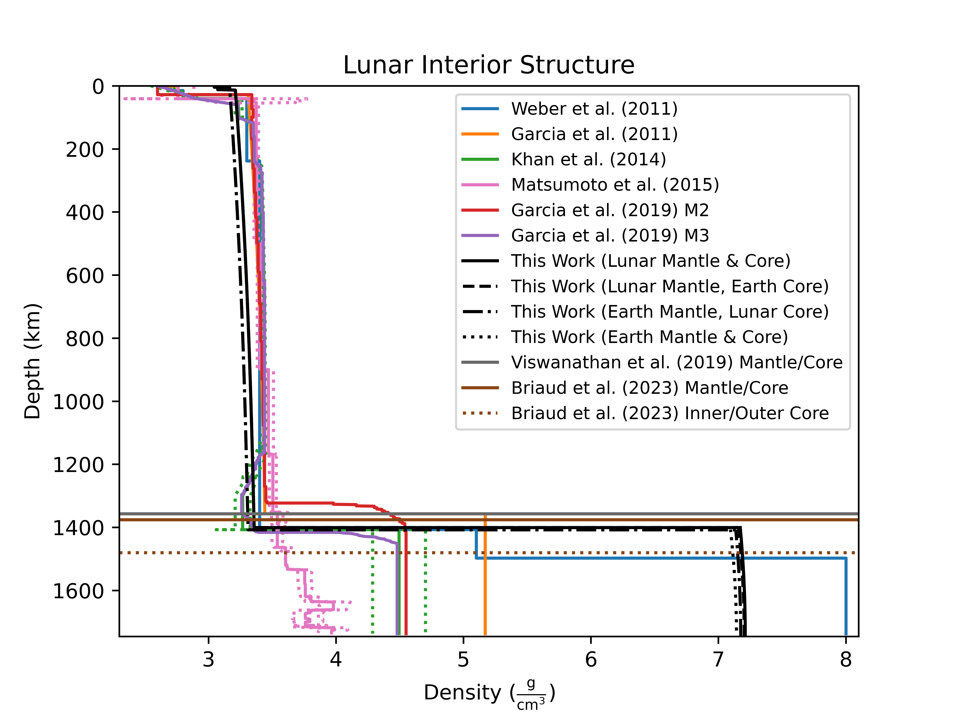
0.44% Radius Error
0.29% MoI Coeff Error

Slide 19
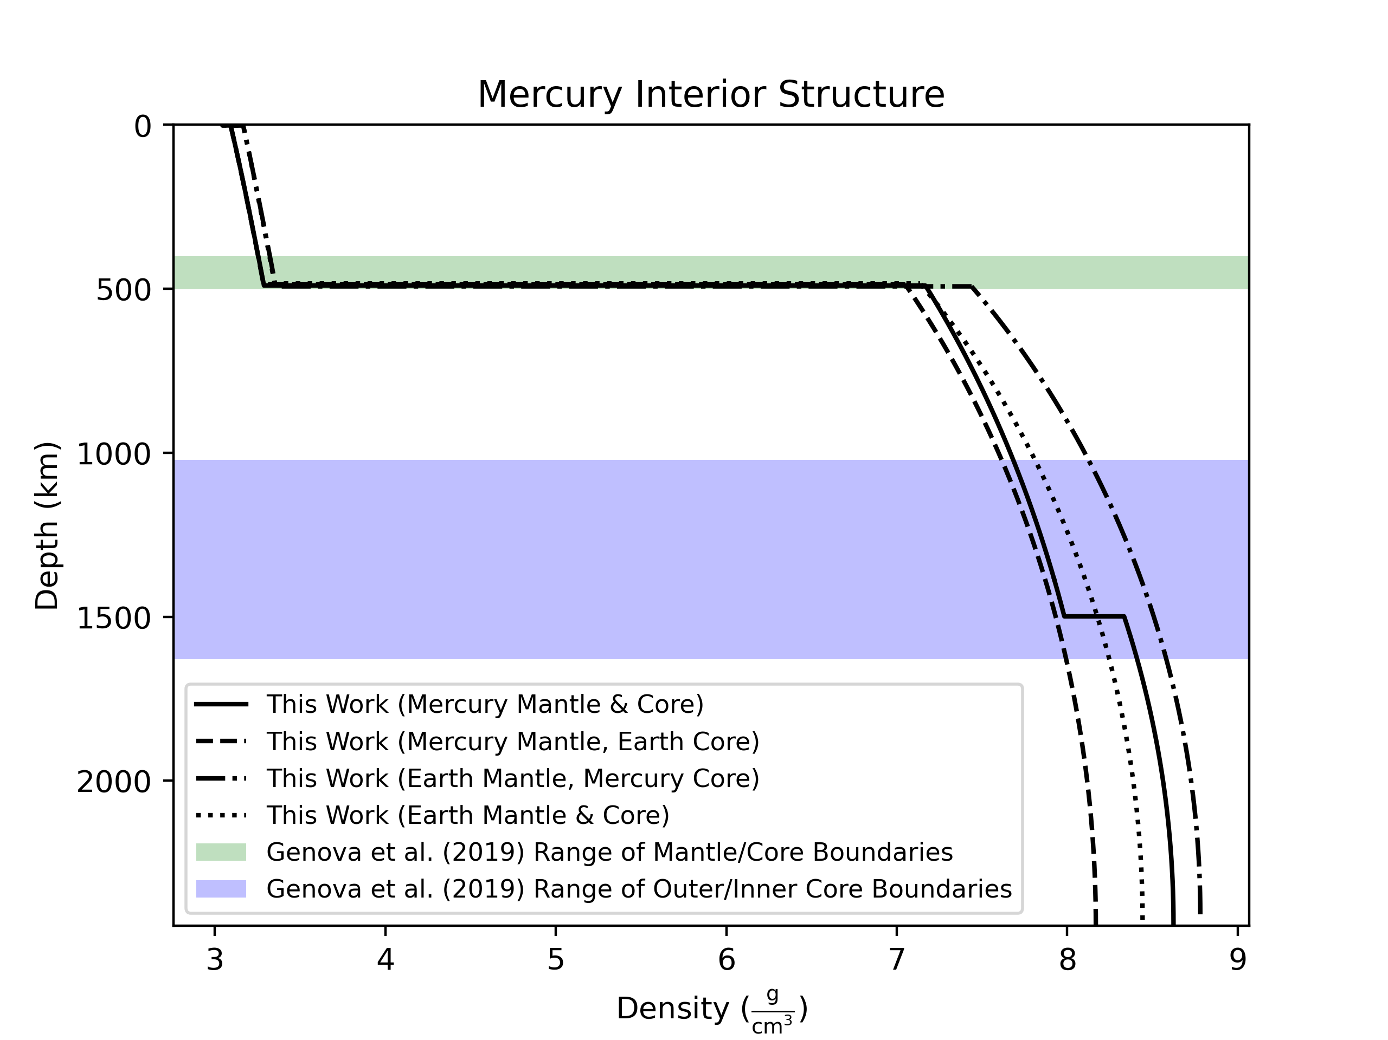
-0.17% Radius Error
0.83% MoI Coeff Error

Slide 20
IV. Results

Slide 21
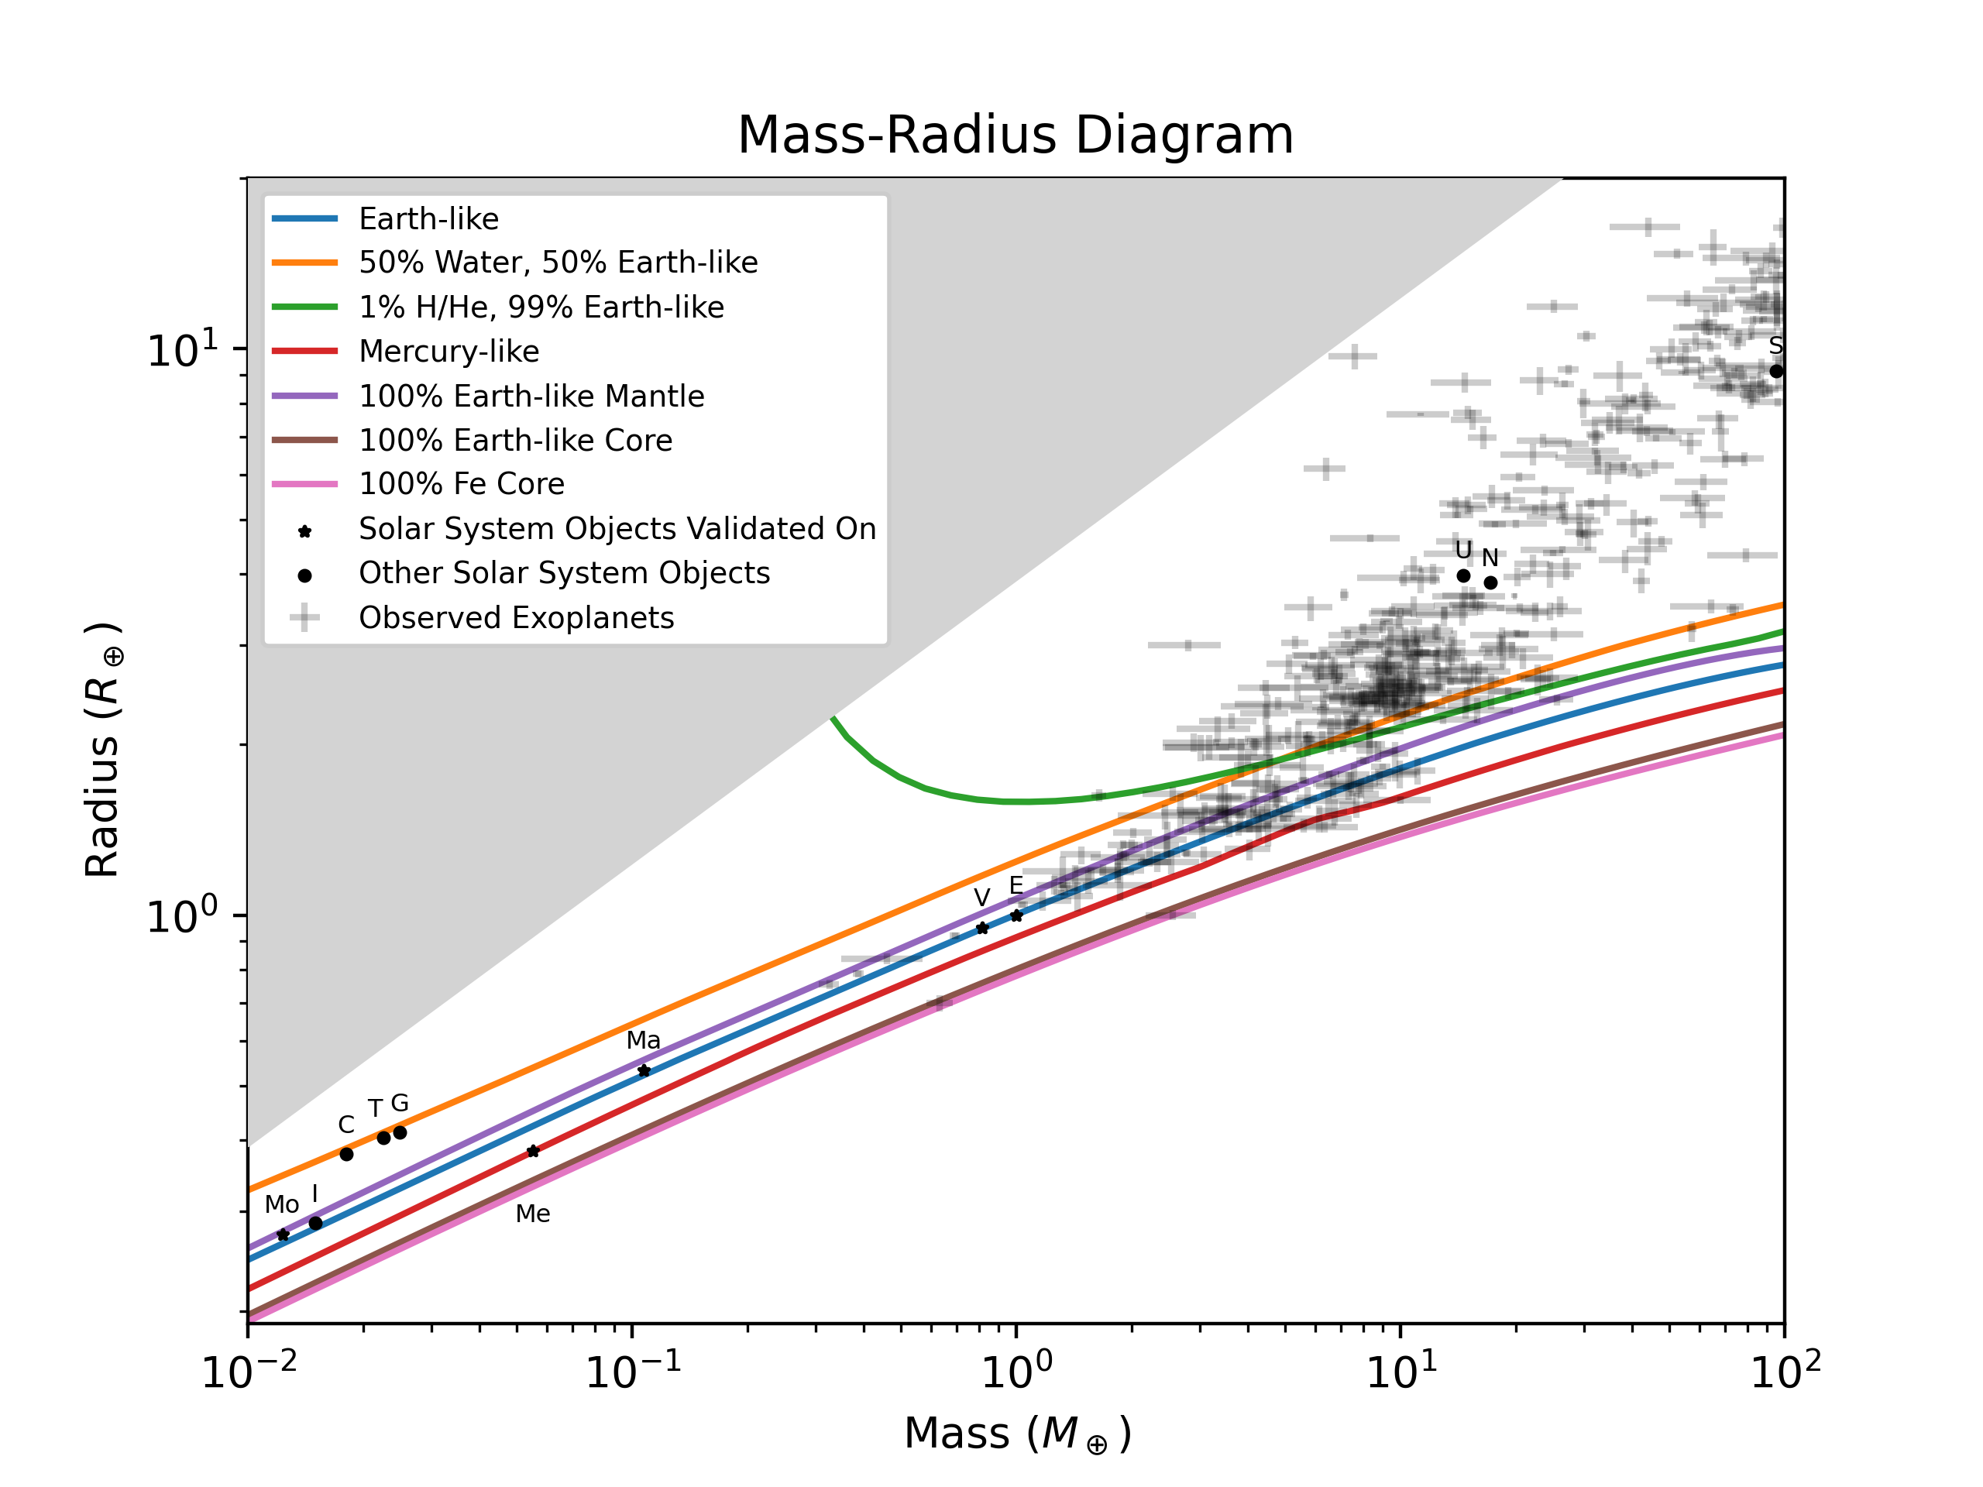
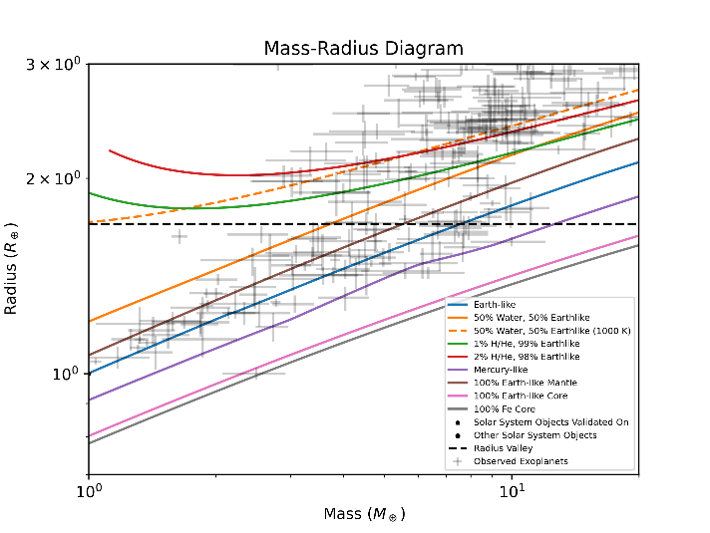

Slide 22
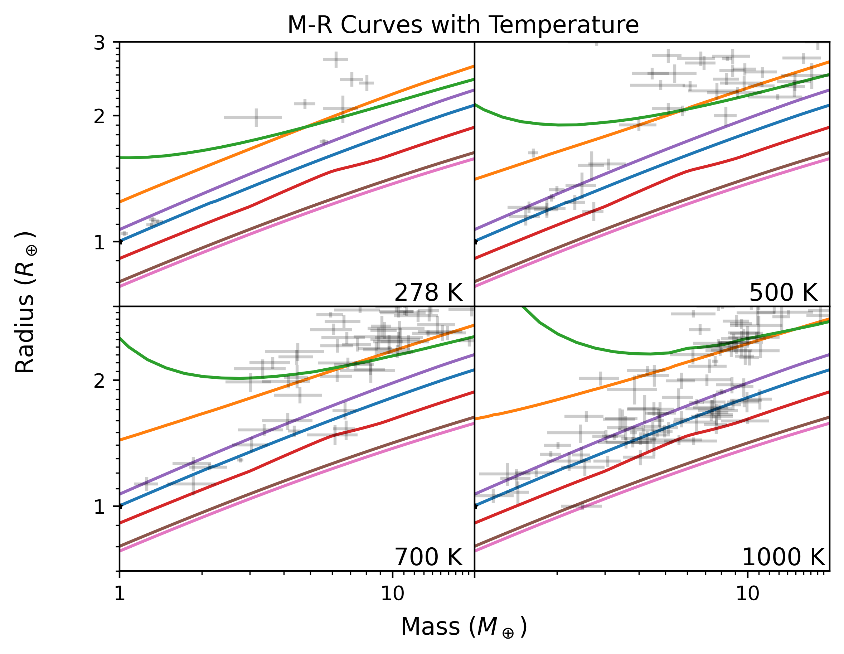

Slide 23
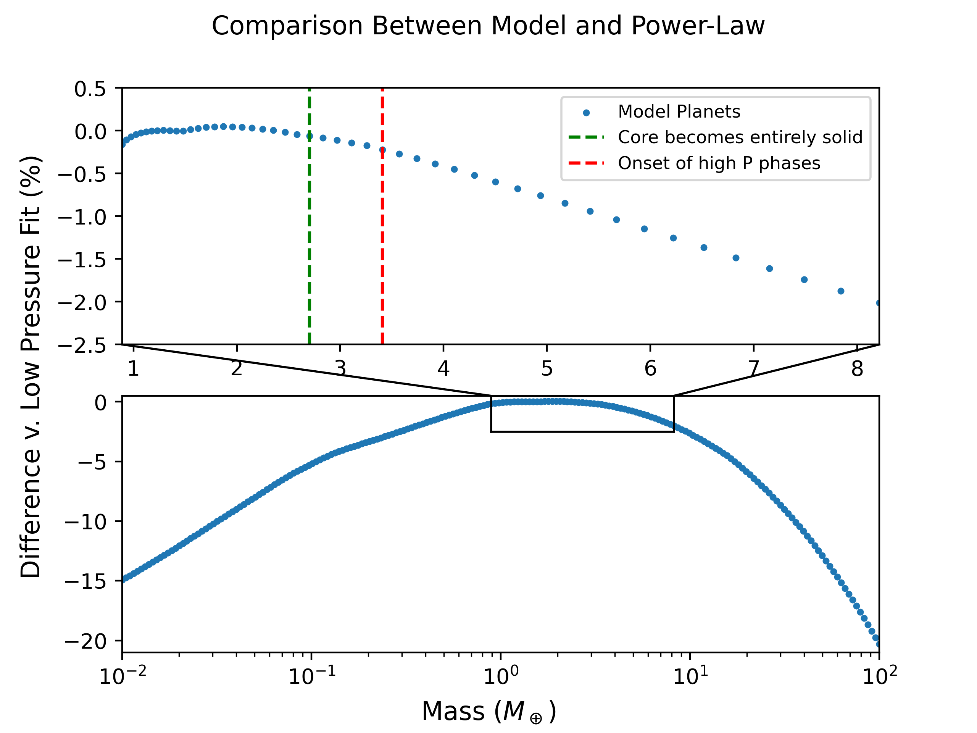

Slide 24
Mass-Radius Power Laws
Mass Range (Earth Masses) | Phase Change | Earth-Like | Water World | Pure Iron
0.89-2.70 | Post-Perovskite | 3.71 | 3.78 | 3.81
2.70-3.41 | Solid Core | 3.81 | 3.88 | 4.04
3.41-8.21 | High P Mantle | 4.04 | 3.98 | 4.36
Power law 3.7-4.4
Consistent w/ past studies (e.g. Dorn et al. 2024, Zeng et al. 2019, Valencia et al. 2006)
Consistent w/ or slightly steeper than observed super Earth population (Chen & Kipping 2017, Otegi et al. 2020, Müller et al. 2024)
Curves largely but not entirely parallel
Compression increases w/ mass, core mass fraction

Slide 25
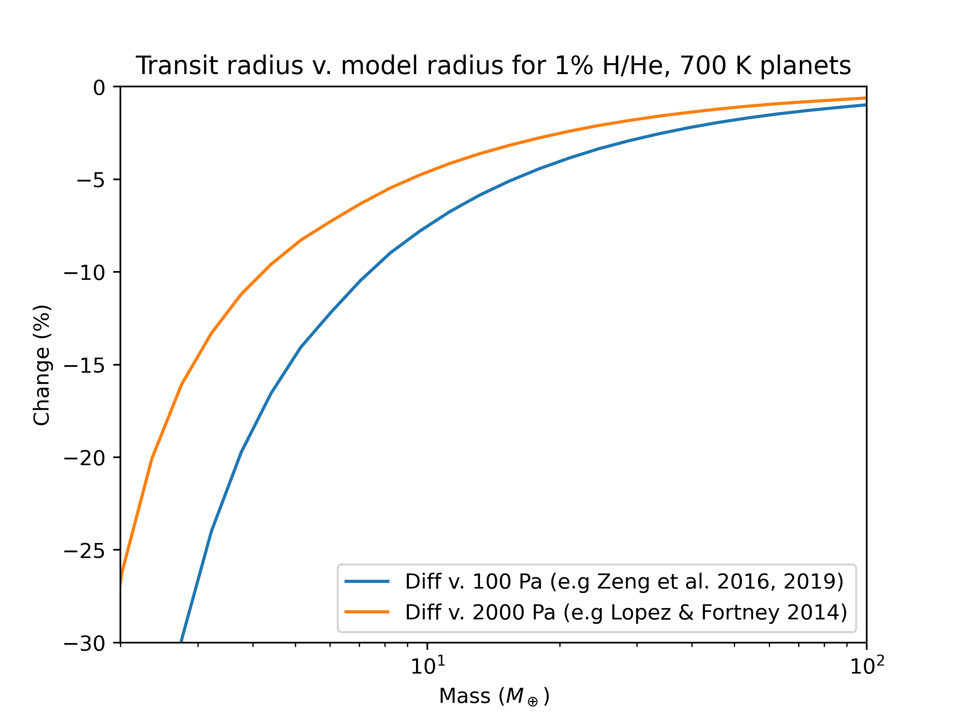

Slide 26
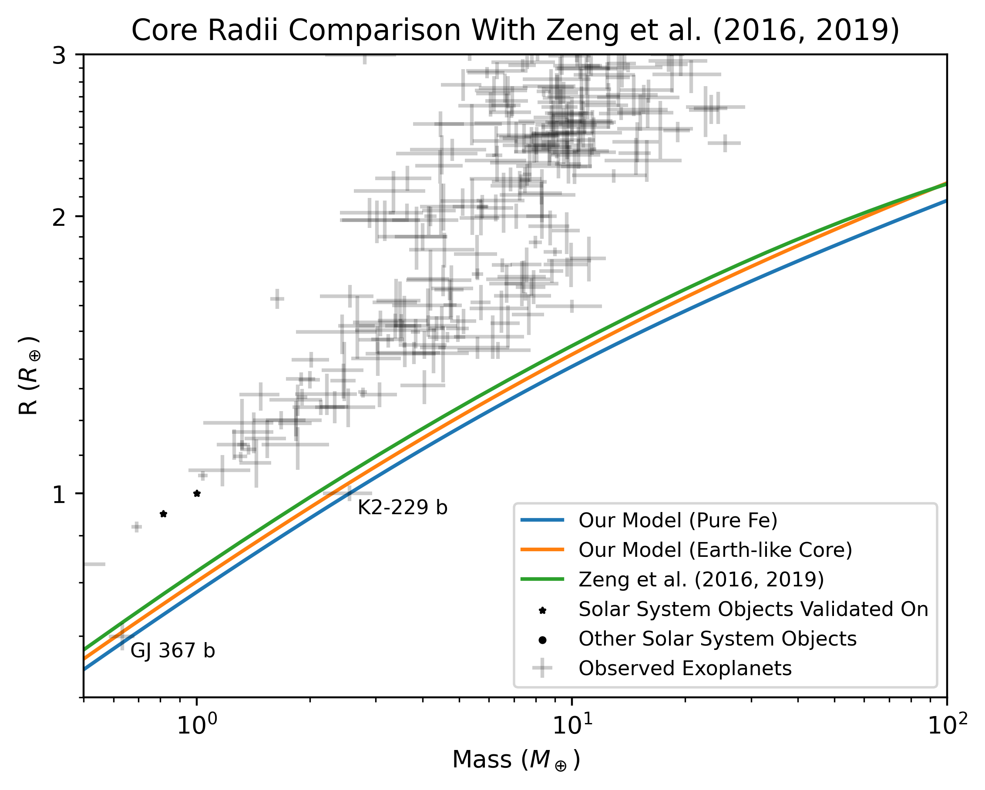

Slide 27

Summary
Determining the composition of exoplanets requires interior structure models
Sub-Neptunes: H/He or water-rich?
Super-Earths: Earth-like composition?
Super-Mercuries: High core mass fraction?
We have created a new interior structure model
Latest Equations of State from experiment/theory
More phases included in all planetary layers
Thermal effects, liquid and solid mantle and core
Transit radius calculated
We validate our model on Solar System Objects
Earth, Mars, and the Moon radii, moment of inertia coefficient errors <0.5%
All density jumps in Earth’s interior replicated
We generate new mass-radius curves
M=R^X, where X=3.7-4.4, increasing w/ planet mass and core mass fraction
Simple power law inadequate to describe entire curve
Radii systematically lower than the literature for H/He and Iron-rich bodies
Mass-Radius Curves Available at https://github.com/Bennett-Skinner/ SkinnerPudritzCloutier2025-MR-curves

Slide 28
Extra Slides

Slide 29
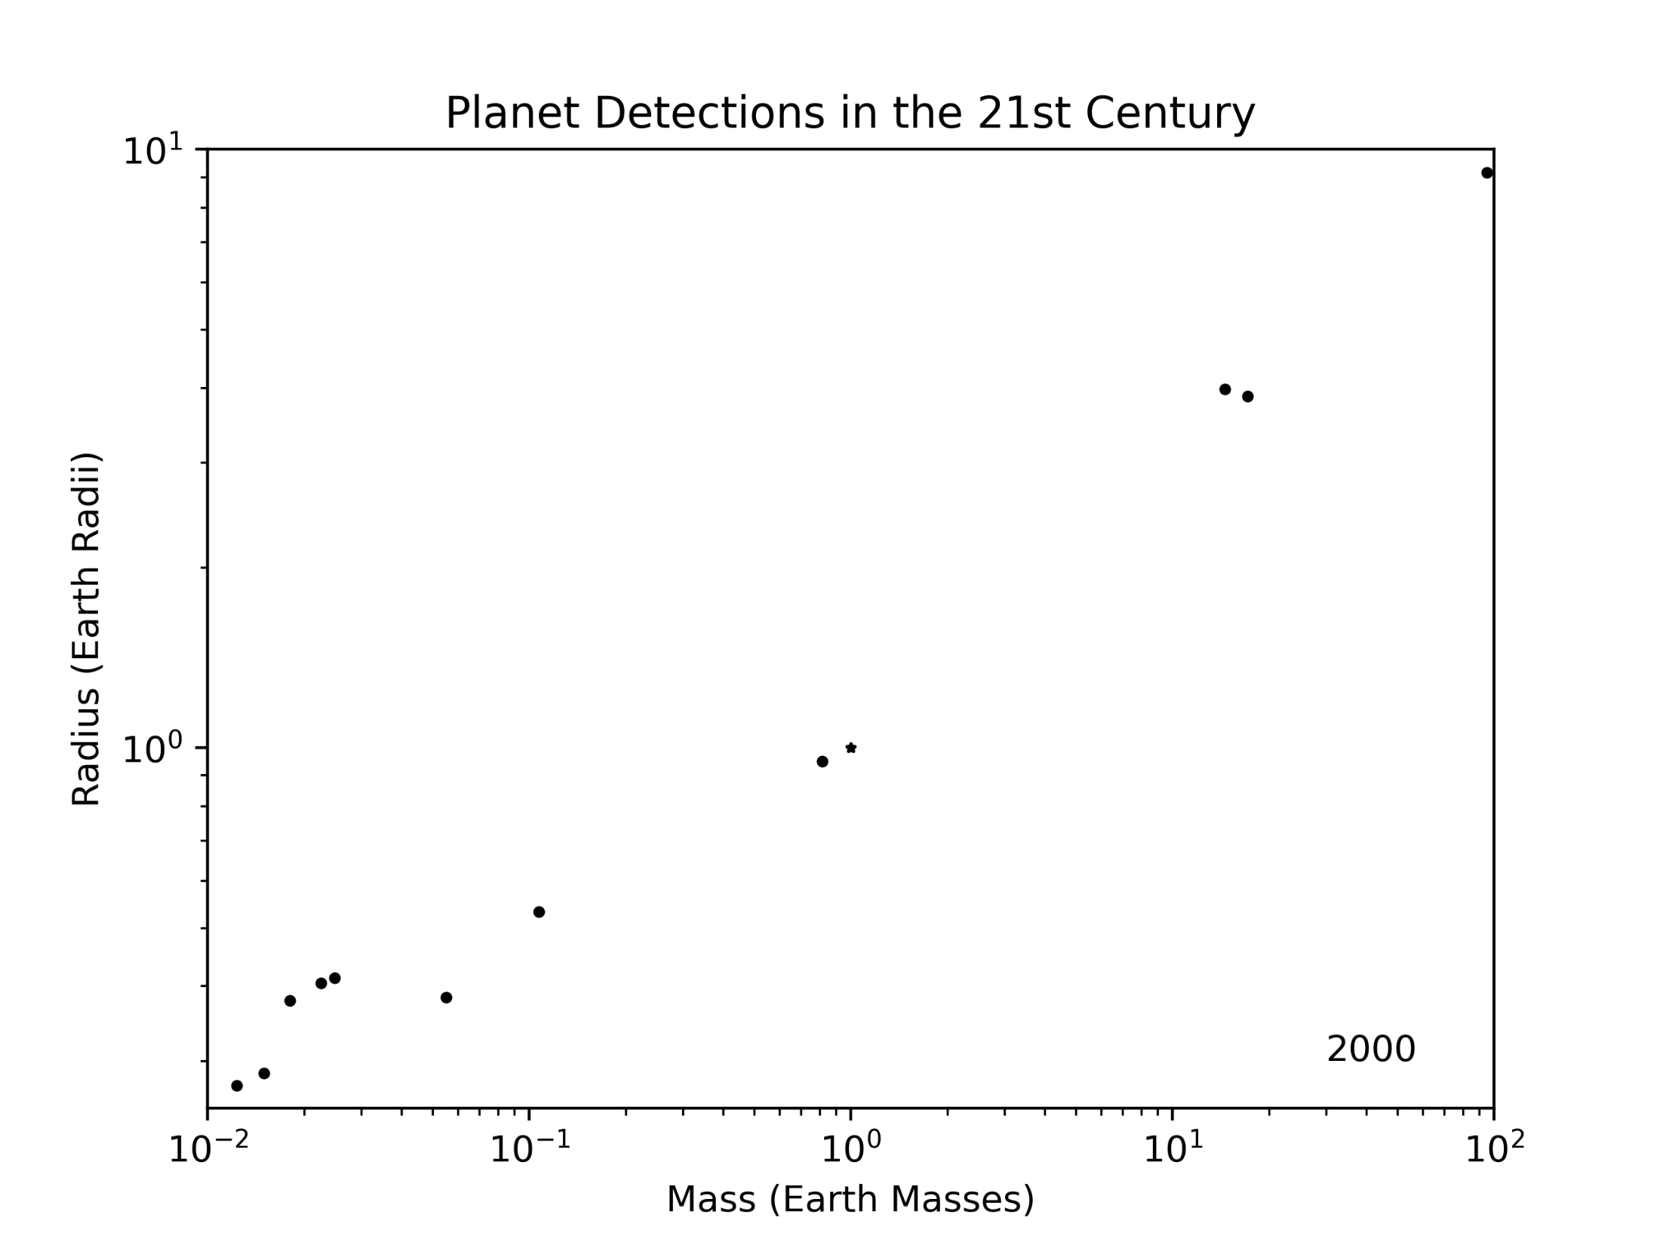

Slide 31
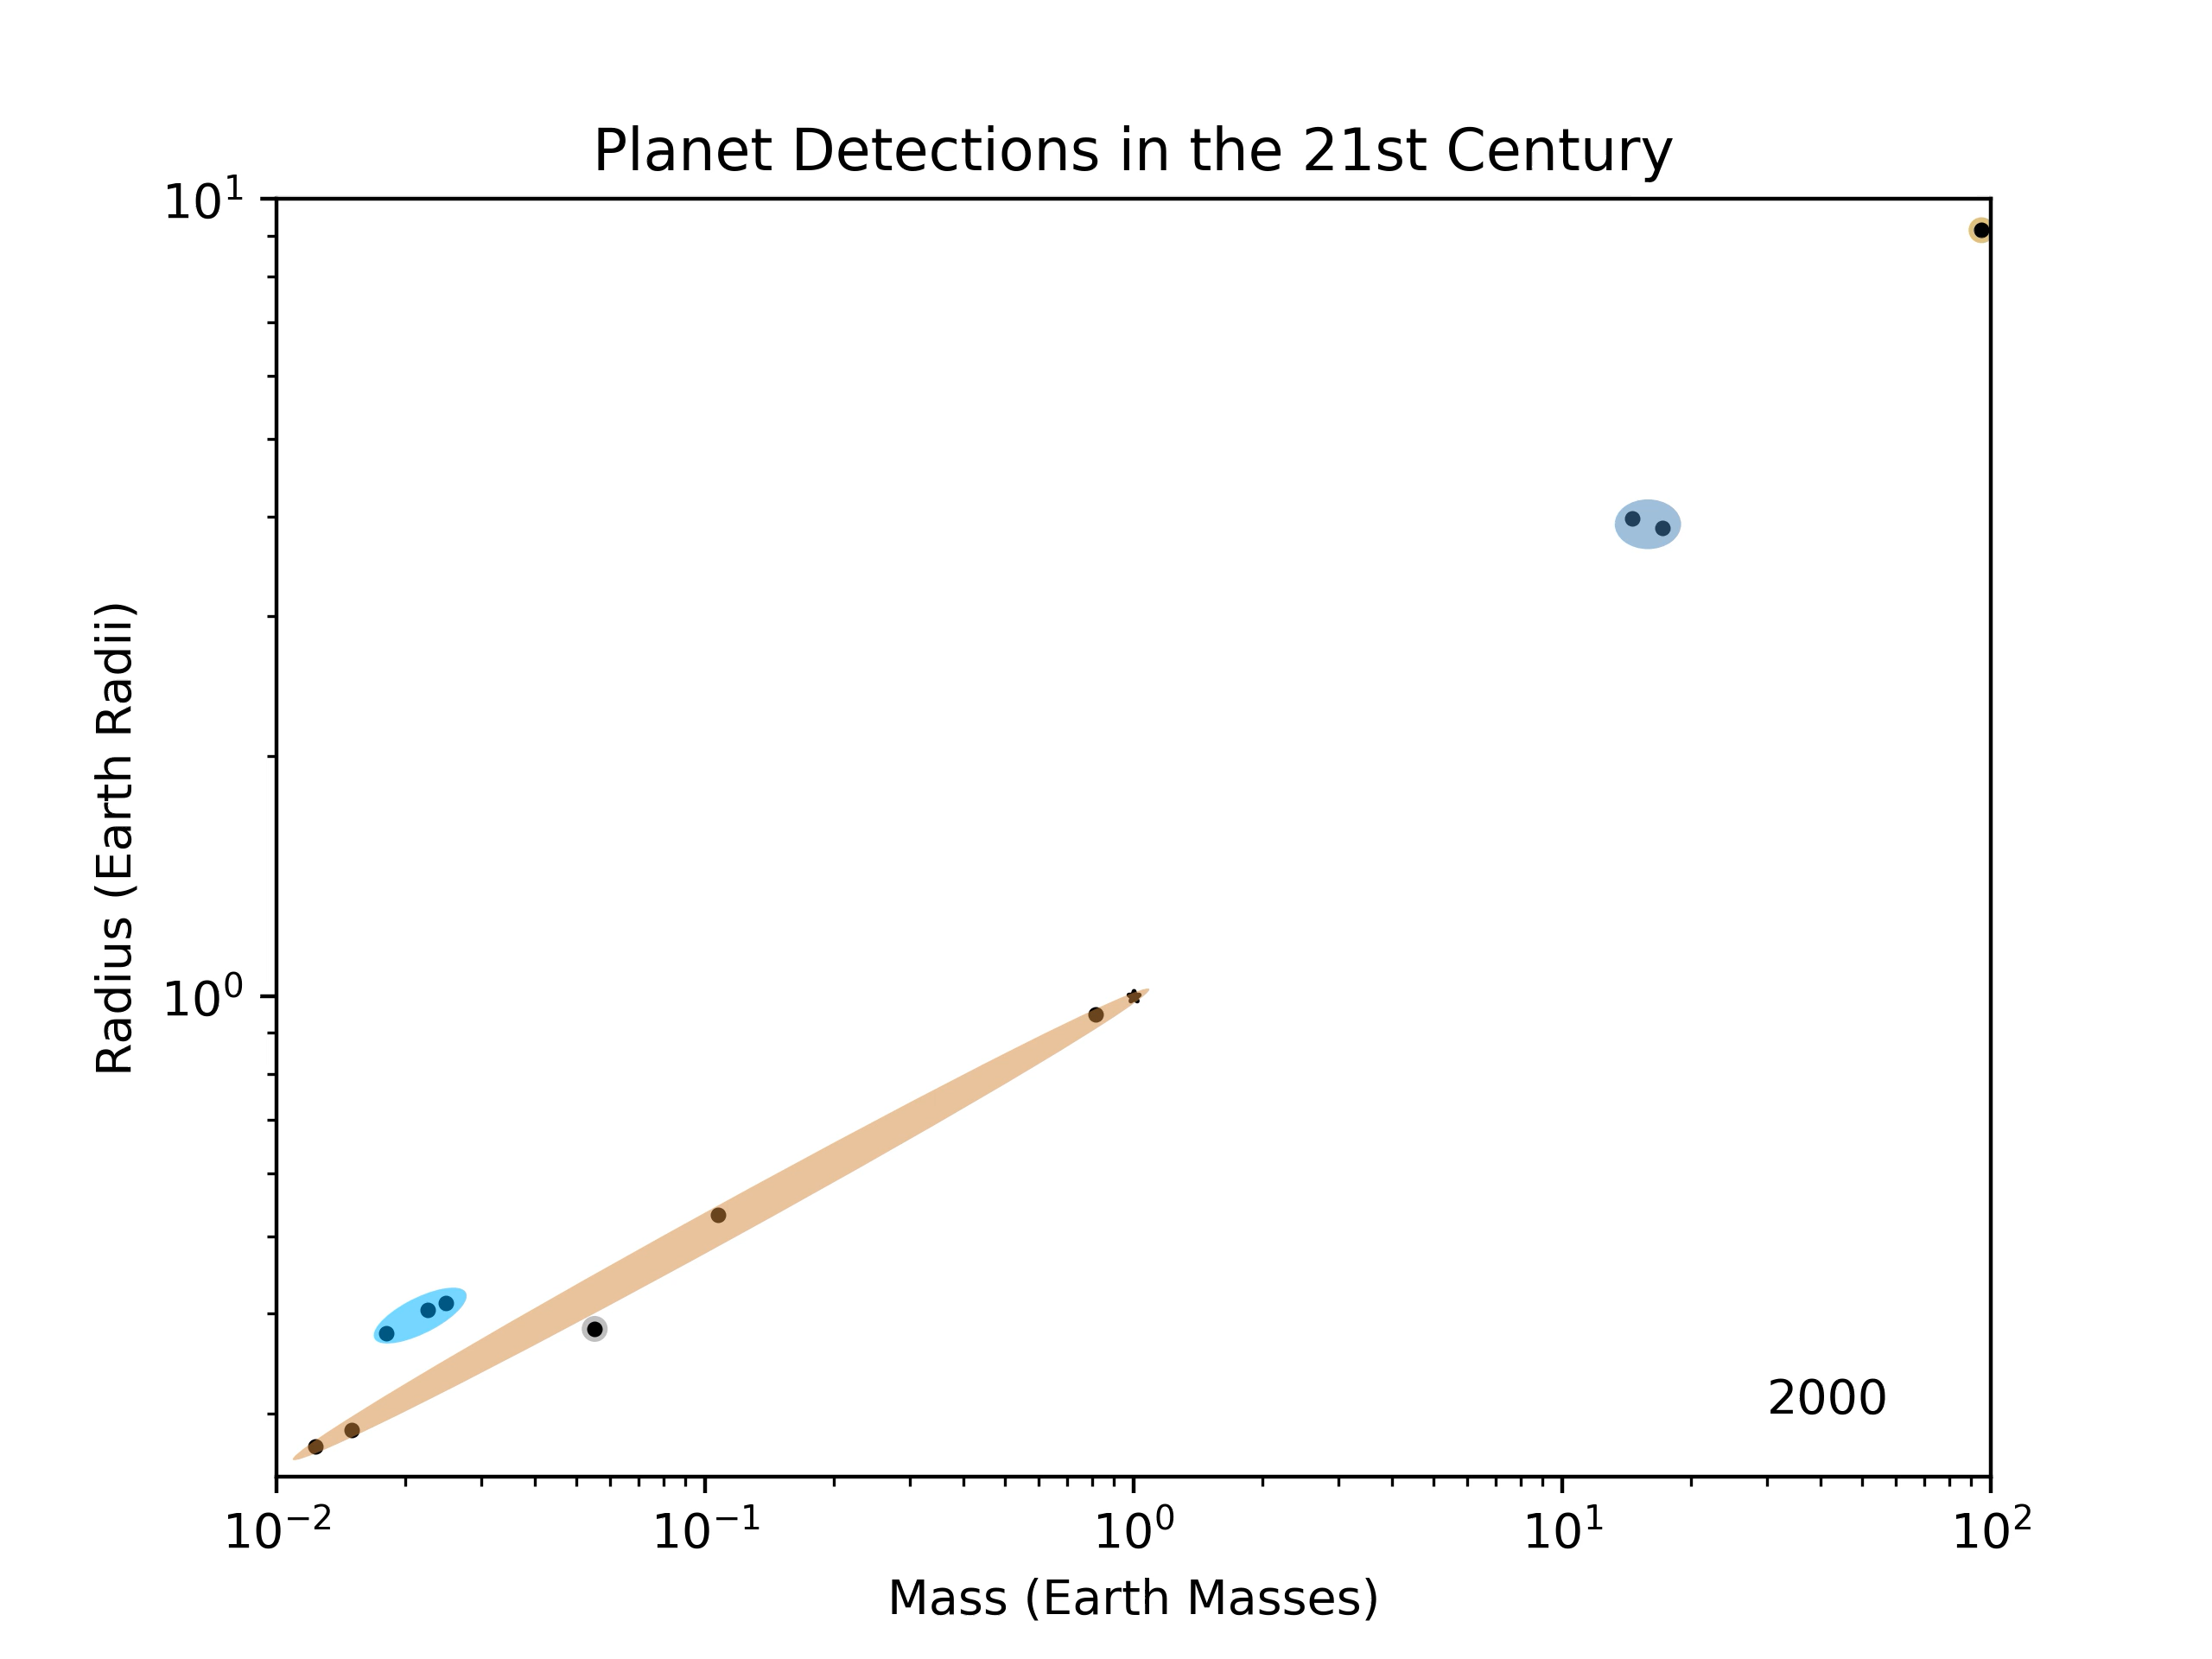

Slide 33
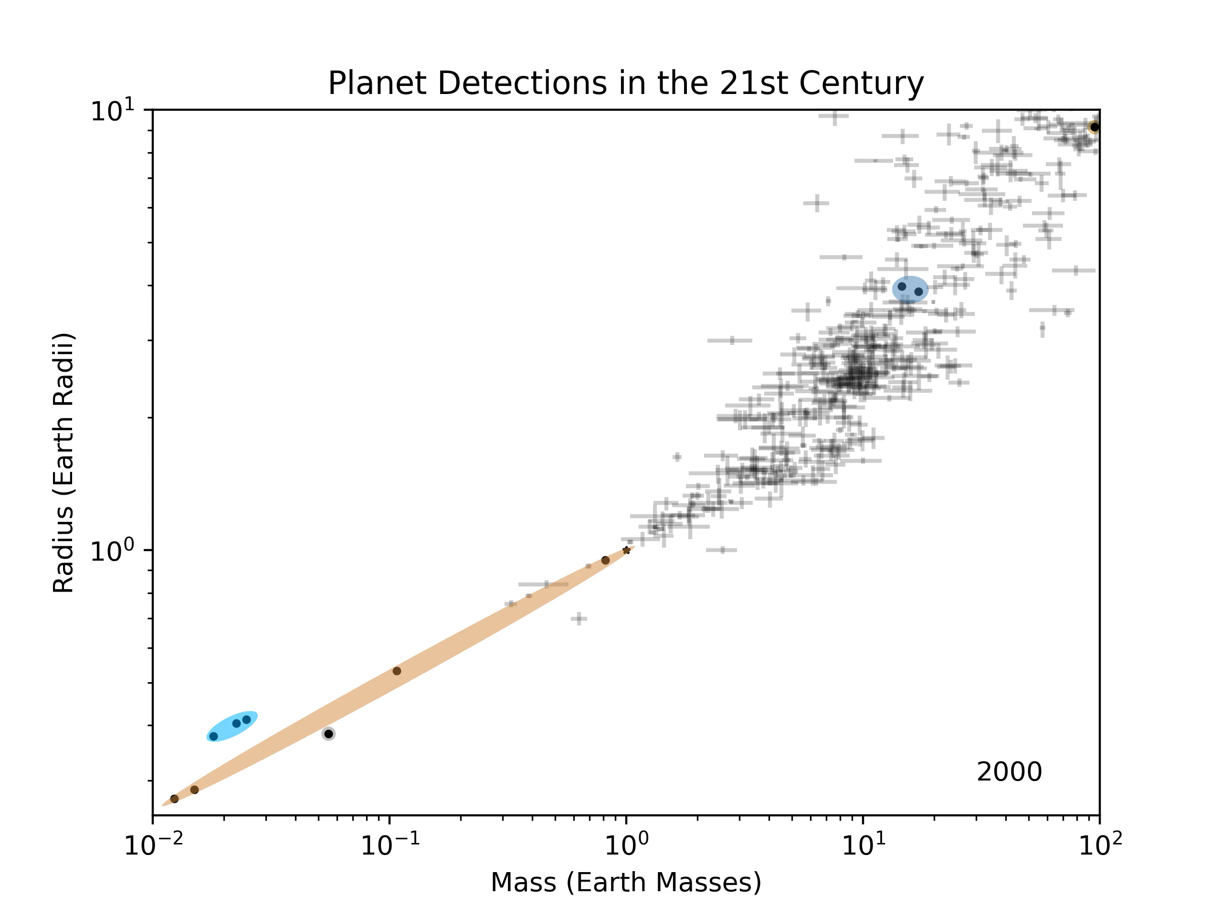

Slide 34
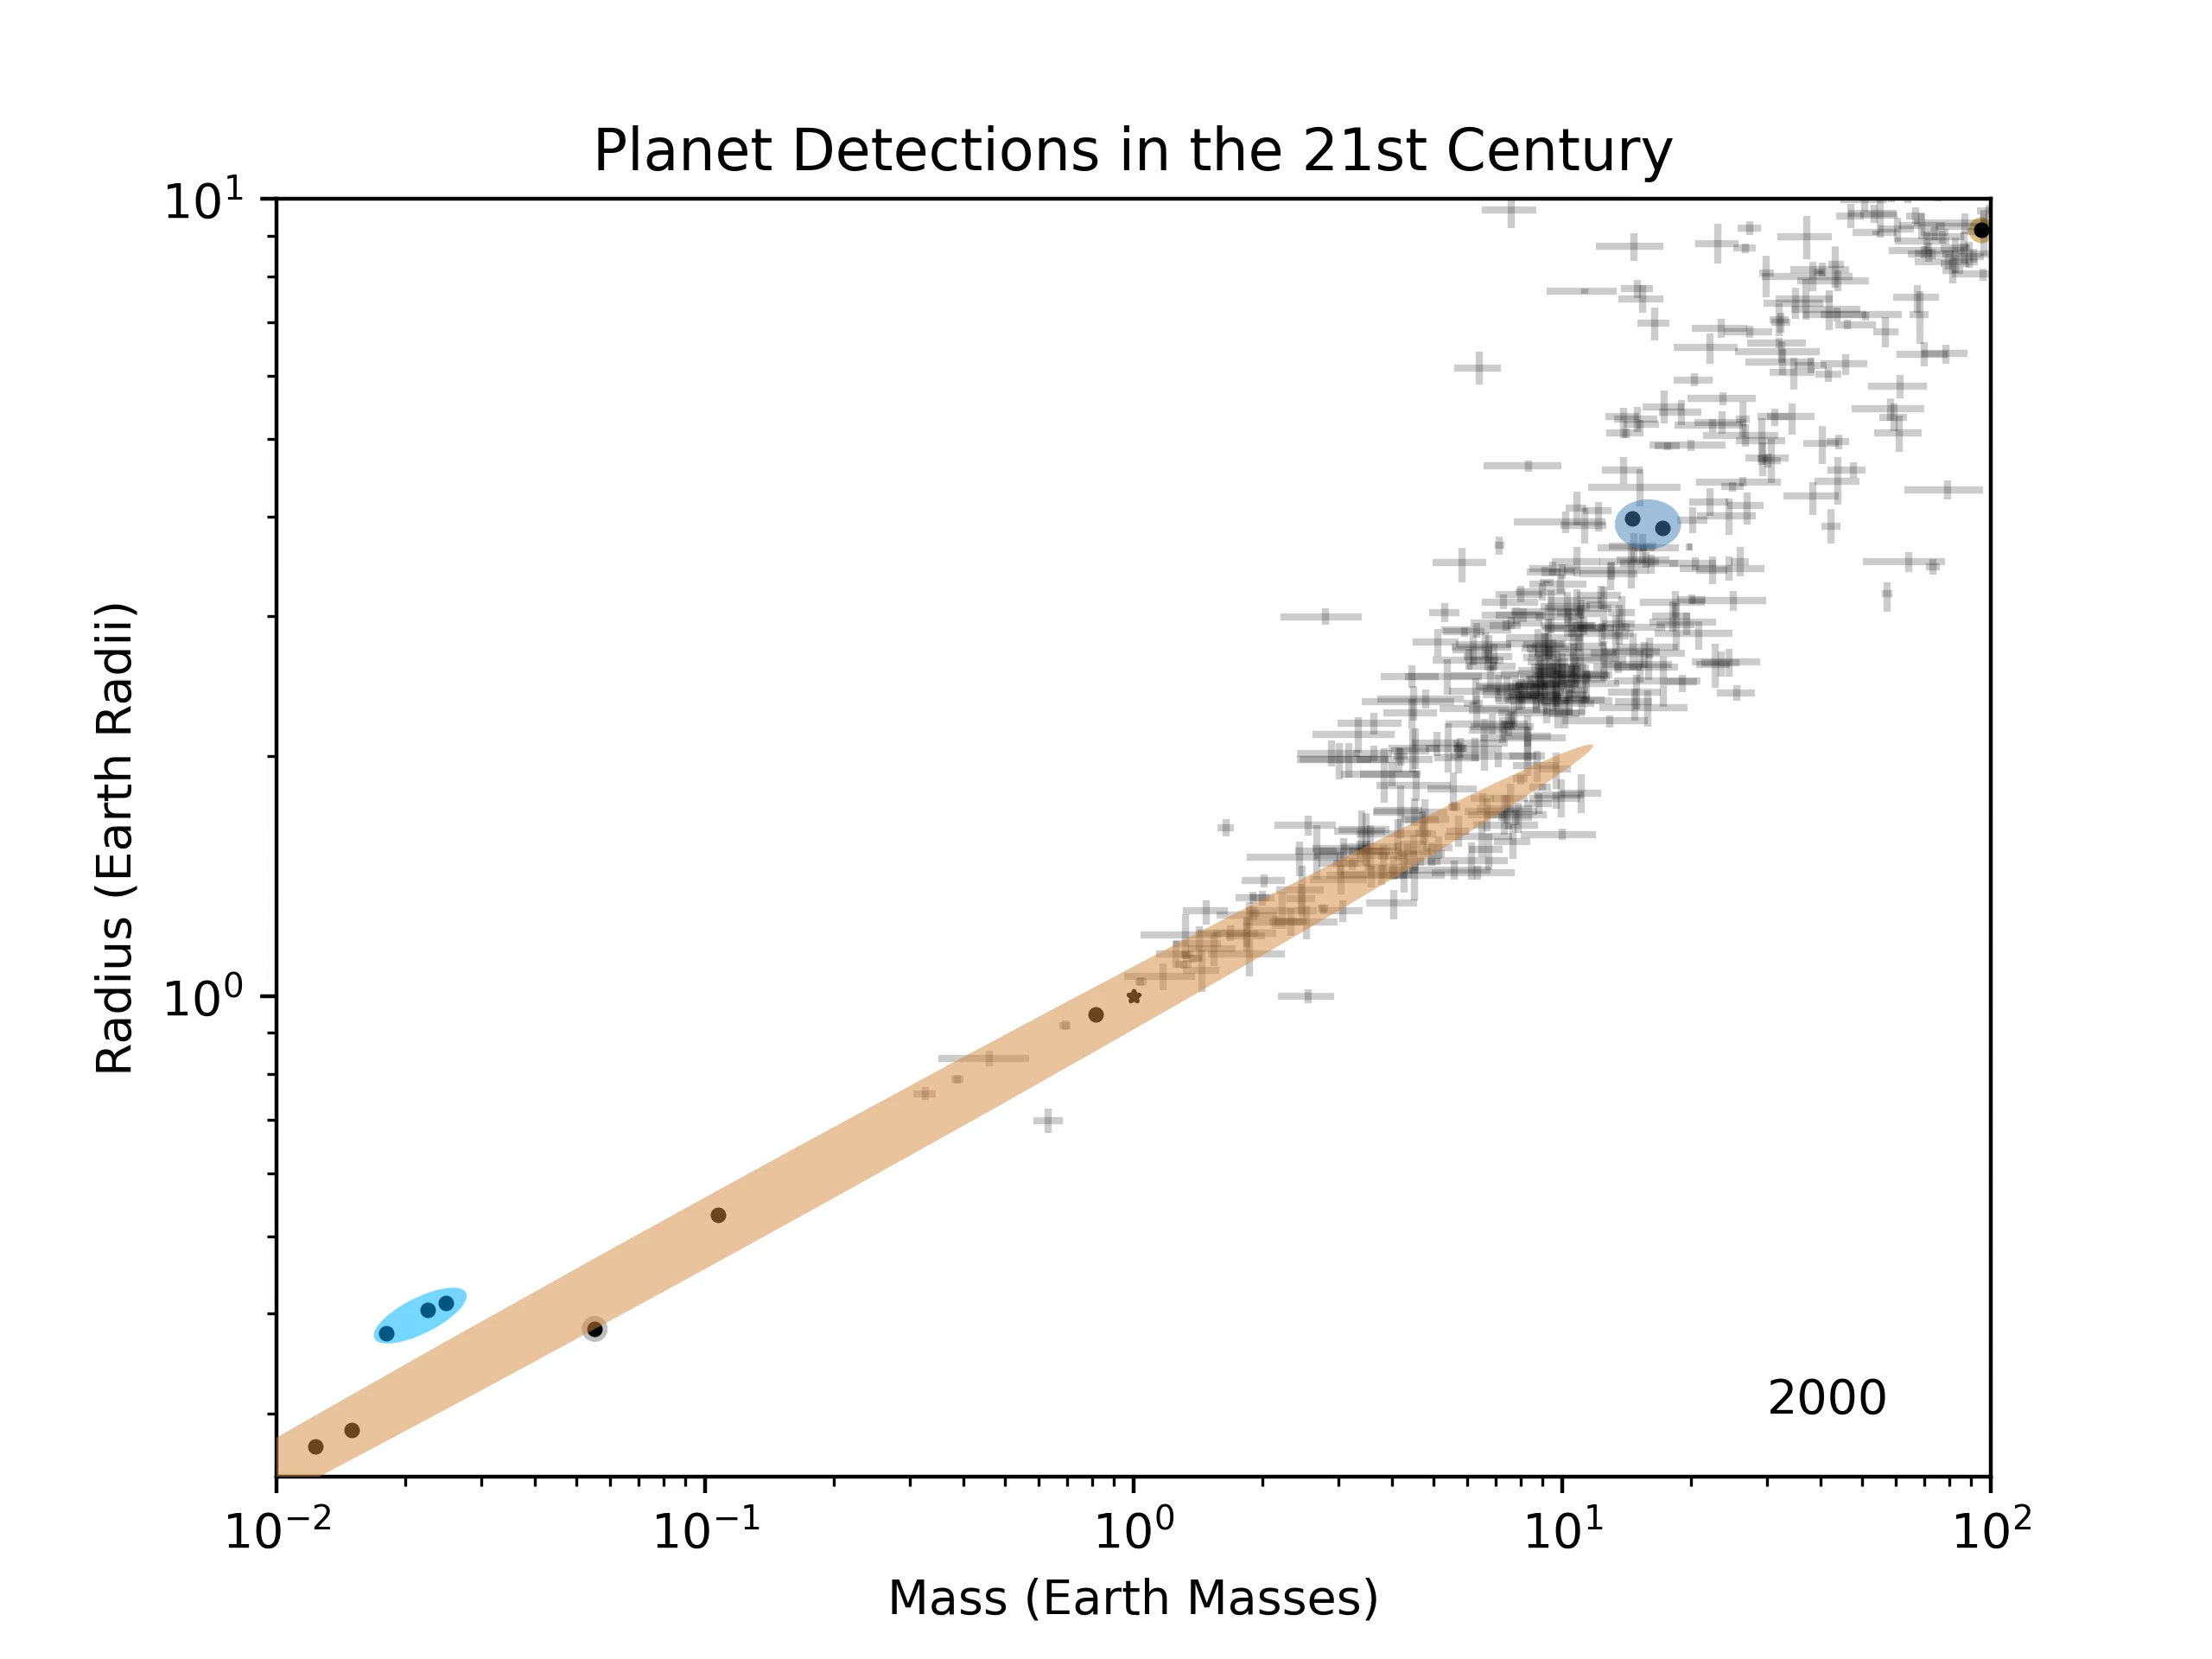

Slide 35
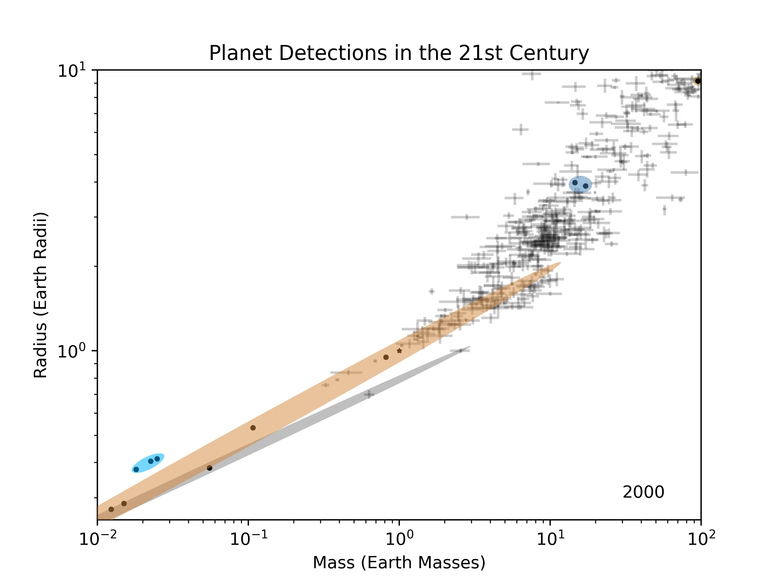

Slide 36
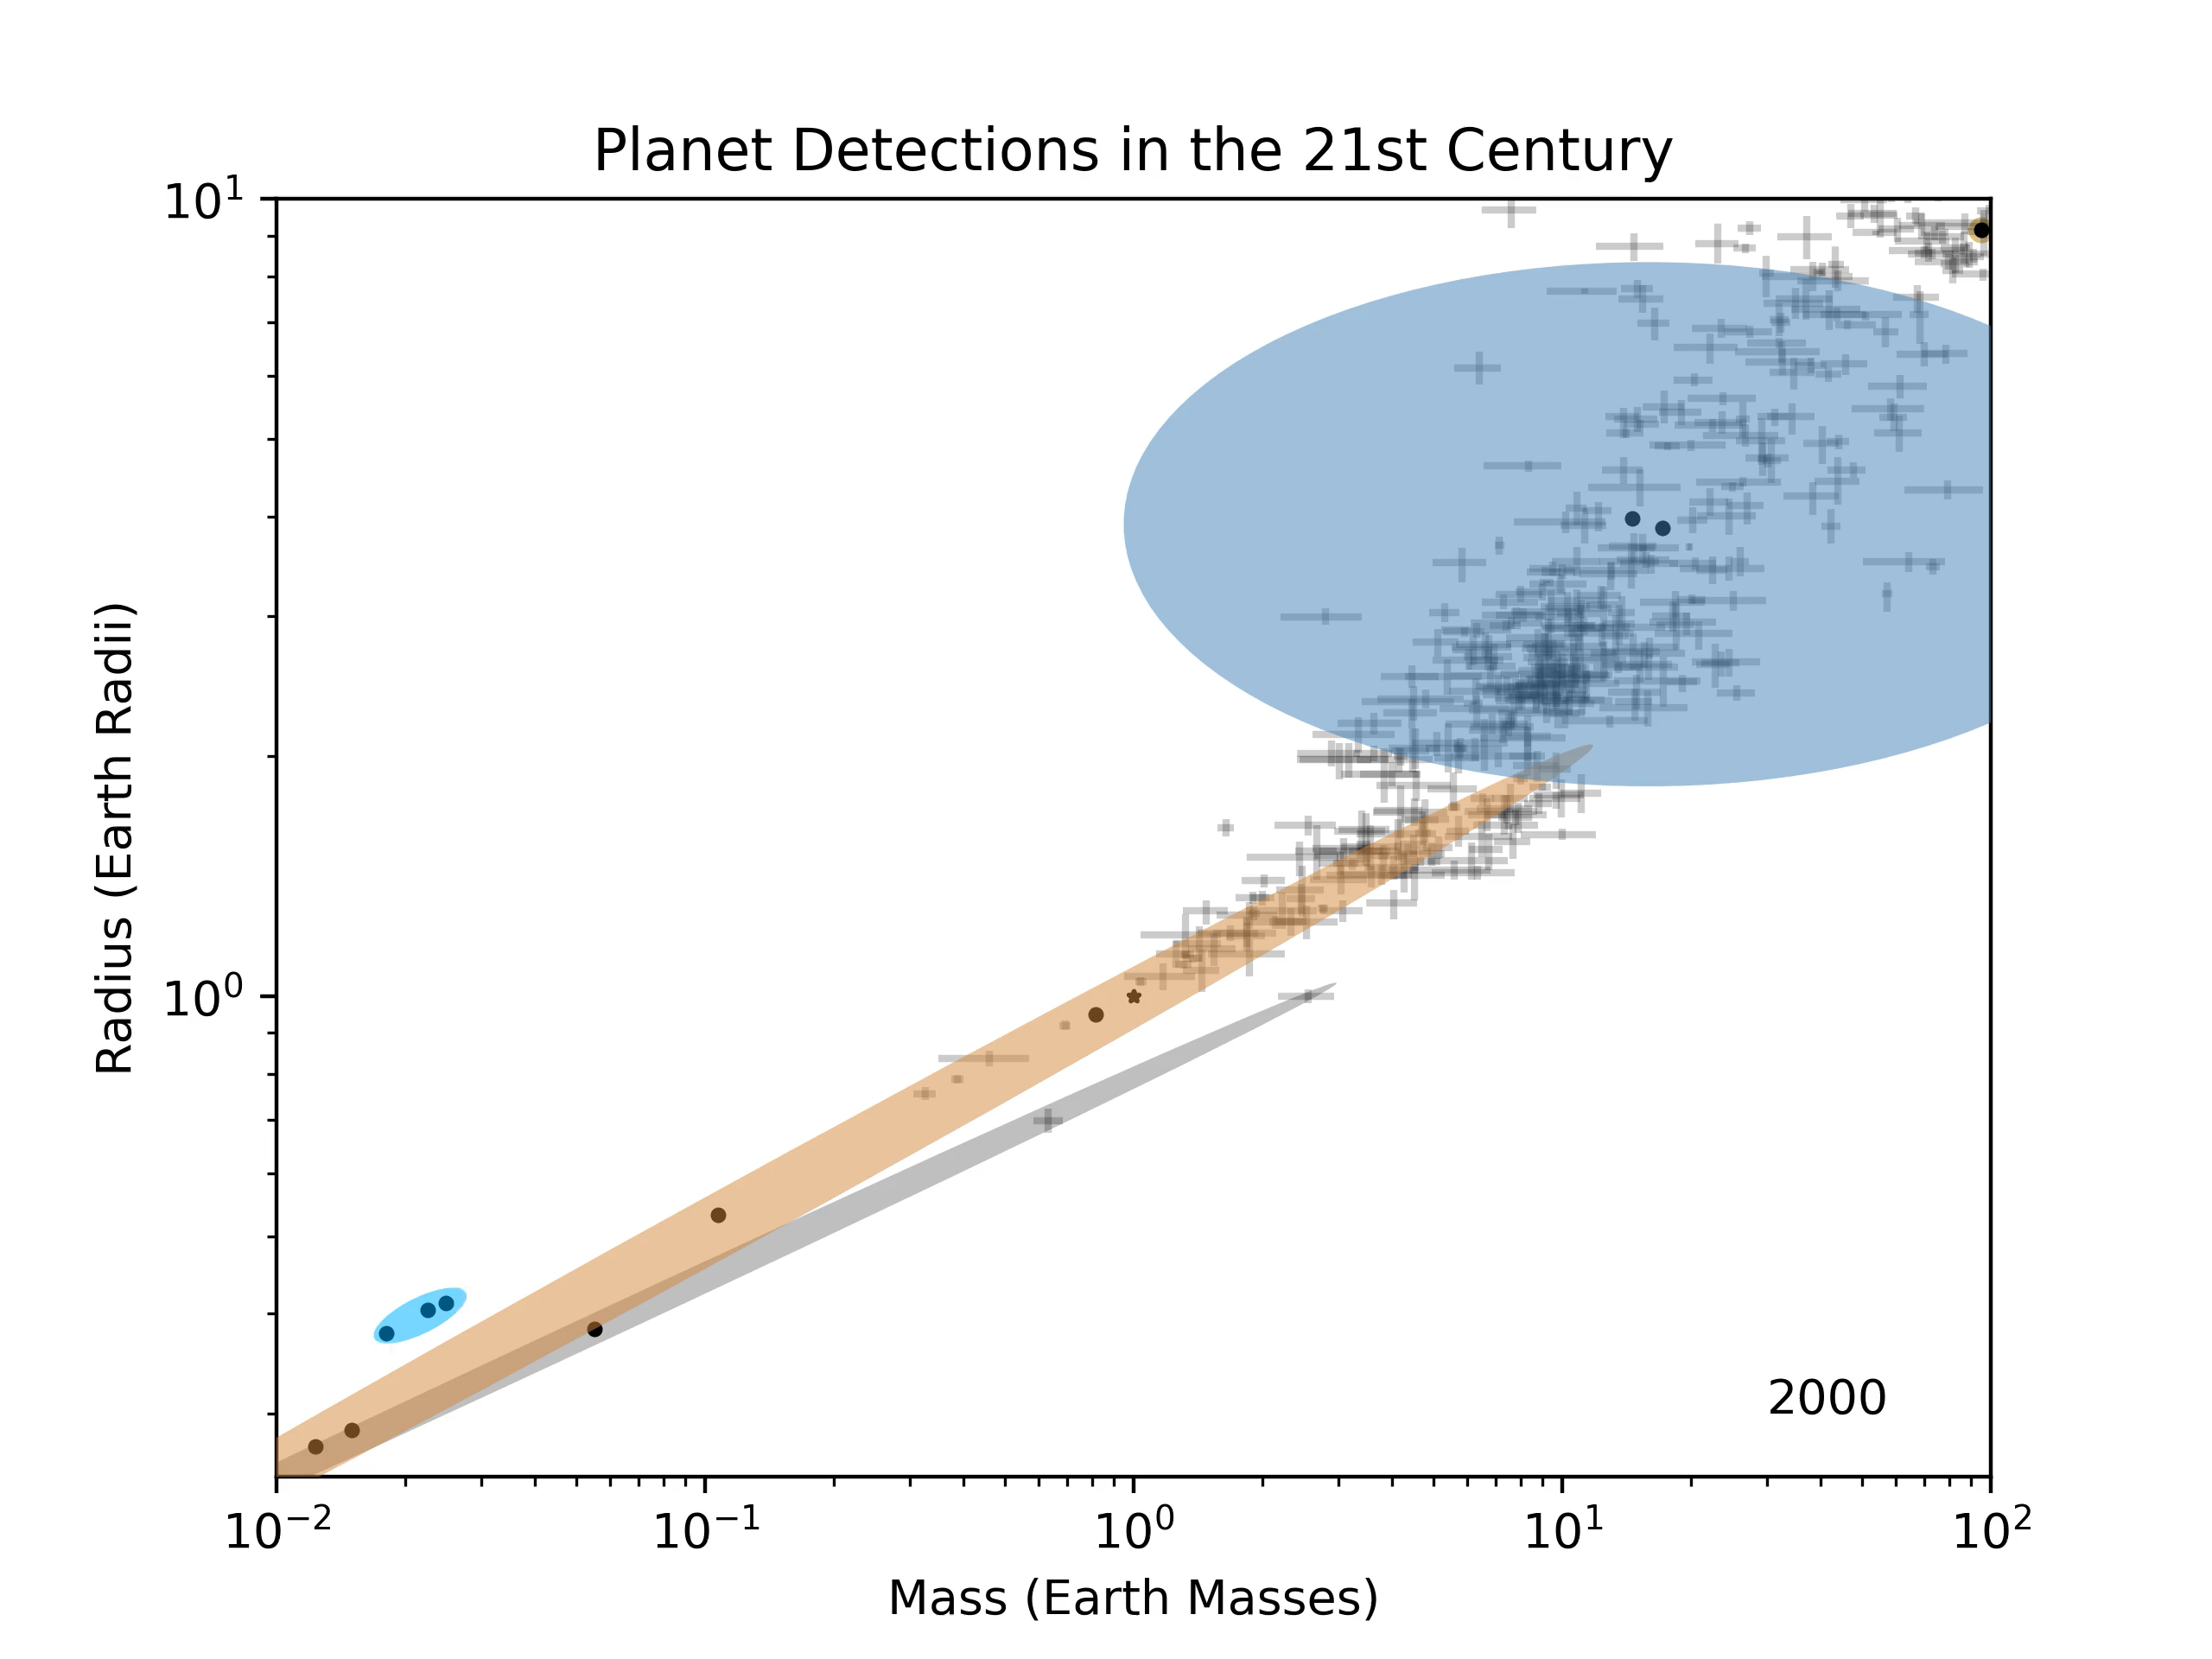

Slide 37
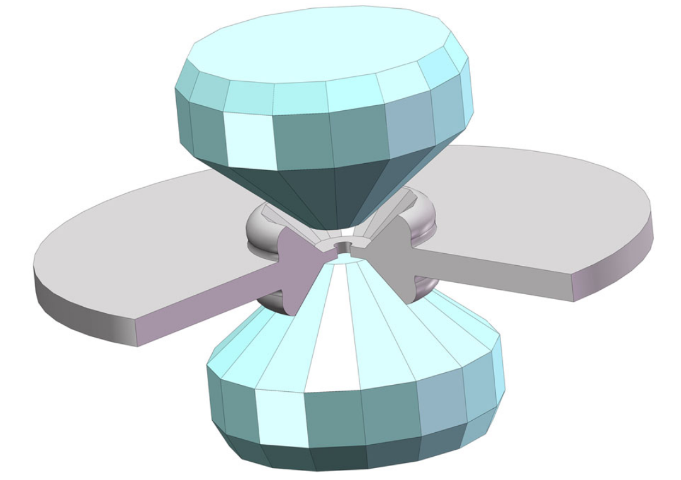
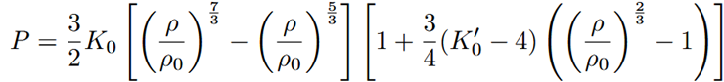
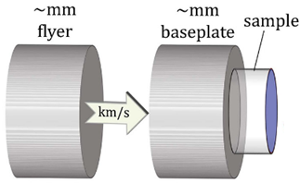
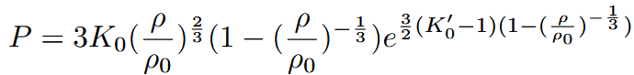
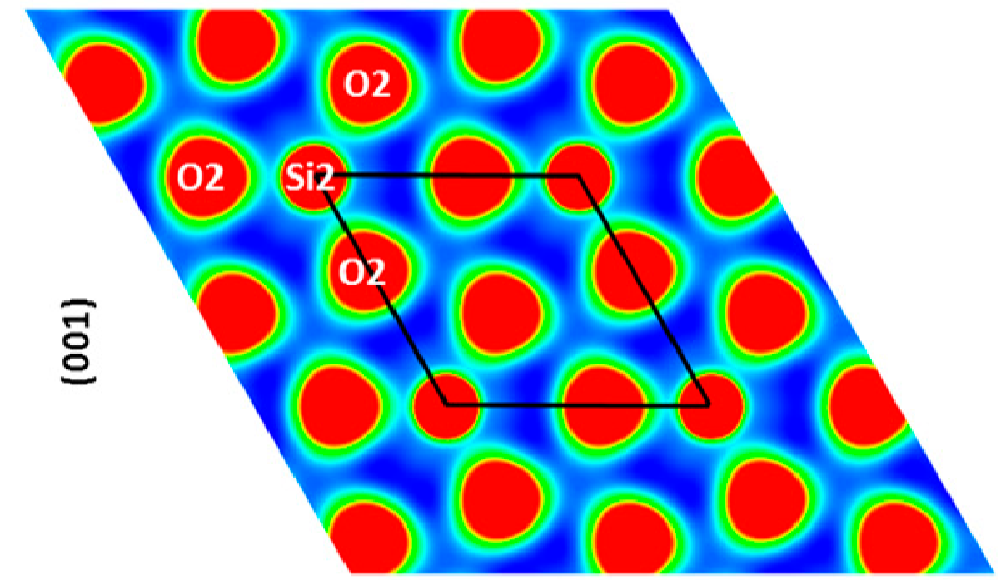
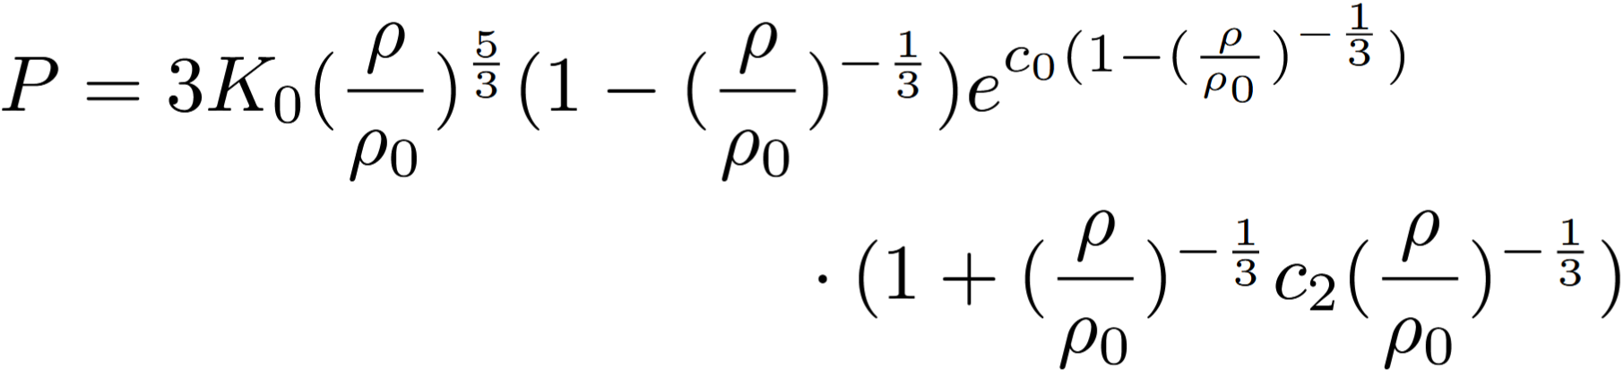
Determining Equations of State
Pressure
Experiment
Function
<100s of GPa
~TPa
>TPa
Top to bottom: Mao et al. (2018), Duffy & Smith (2019), Tsuchiya & Tsuchiya (2011)

Slide 38
The Sub-Neptune Mystery
Water World
H/He-enveloped
50% Water, 50% Earthlike 700 K Equilibrium T To Scale
1% H/He, 99% Earthlike 298 K Equilibrium T To Scale

